Slide 1
Egypt Imports Analysis
Across all Sectors from 2005 : 2023
(23/10/2024)

Slide 2
Team Members
Amani Mustafa Mahmoud | Data cleaning and preprocessing
Mohamed Eid | Creating physical database
Mahmoud Fawzy | EDA (Exploratory Data Analysis) Using SQL querying
Mohamed Yehia | Data Visualization
Mahmoud Al-Sayed | Recommendations and solutions study
Maher Mahmoud Maher | project facilitator, predictive analysis, presentation

Slide 3
Tools Used
Asana | Project Management Tool
Excel (power query) | Data cleaning and preprocessing
Mermaid.js | ER diagram
SQL Server | As a Database Engine
Python | Using Keras for Predictive Analysis
PowerBI | Developing Star schema | Dashboards and Visualization
PowerPoint | Story Telling | Presenting

Slide 4

Objectives
Using the data that Central Bank of Egypt Provided for Egypt Trades from 2005 to 2022:
Assess economic performance
Forecast future trends
Support informed decision-making
Track subsequent changes
Targets:
Policymakers - Business stakeholders

Slide 5

Data Source
Central Bank of Egypt
( Economic Studies > Time-series > International-Trades )

Slide 6
Analysis Stages
01
02
03
04
05
06
Data cleaning
Physical DB
EDA
Visualizations
Recommendations
Predictive Analysis

Slide 7
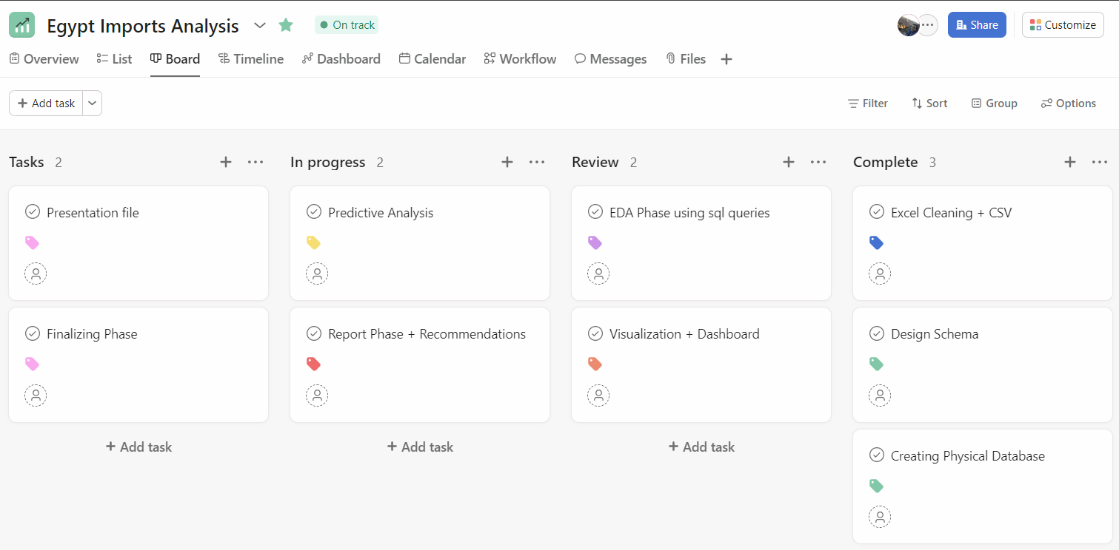
Kanban Board Using Asana as Project Management Tool

Slide 8
01
Data cleaning and preprocessing

Slide 9
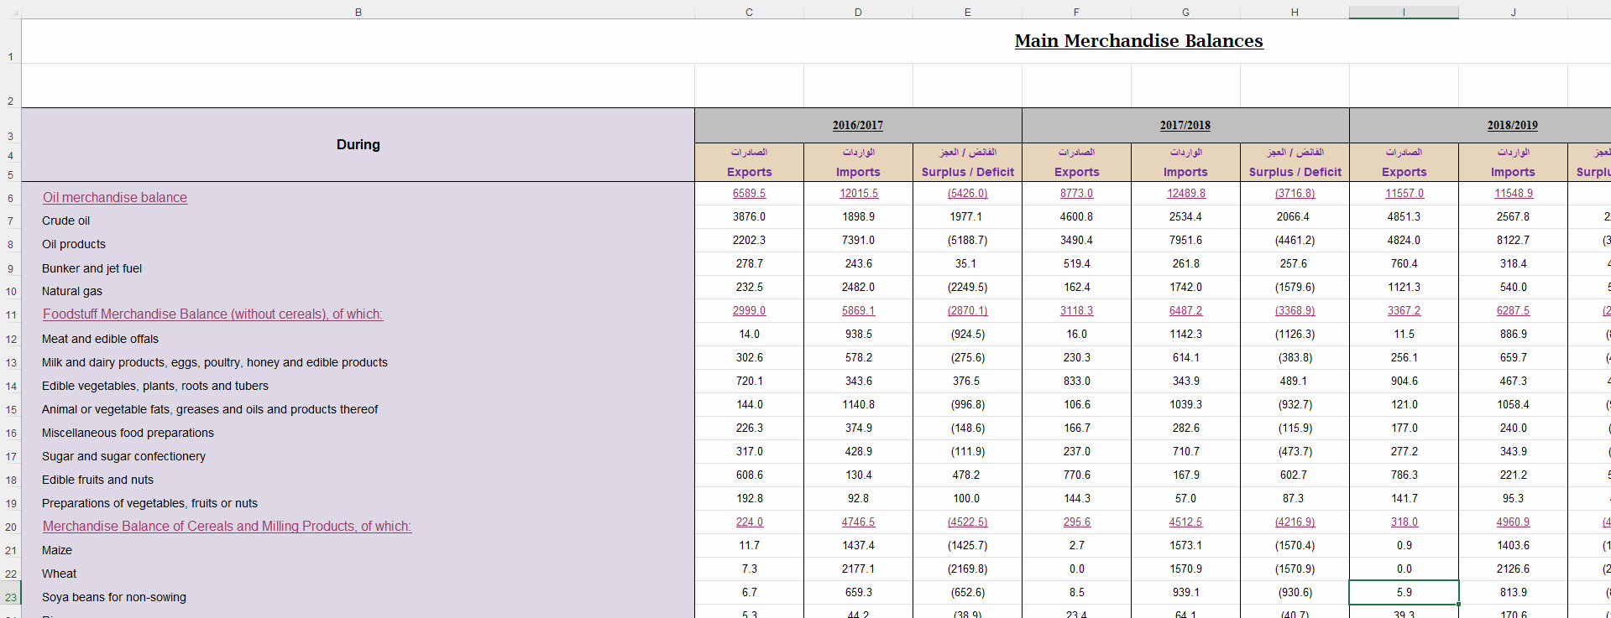
Raw Data
Data were split into 2 files in Excel one for data of 2005 to 2016 ,The second for data of 2017 to 2022
AND both are in pivot form

Slide 10
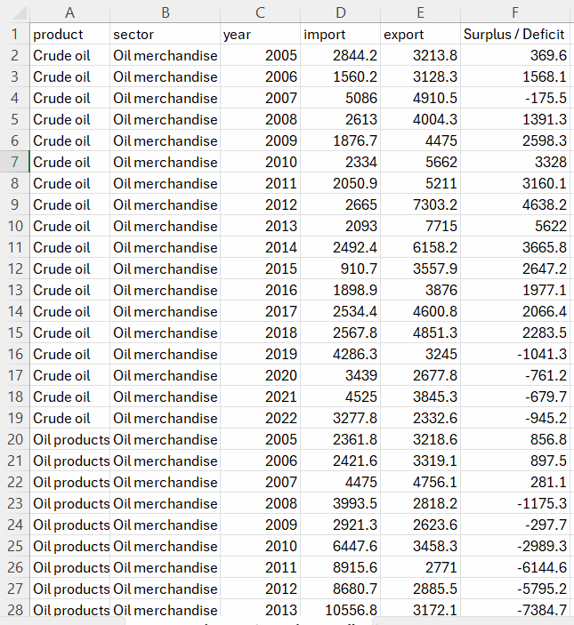
Data preprocessing
Merging the 2 files into one
REMOVING the addition columns and blank row
Checking for Errors or missing values
Standarize the year format
5. Using PowerQuery for Un-pivotting and transforming it into Tapular form
6. Export the Outcome into CSV file
Data Unpivoted

Slide 11
02
Creating physical database

Slide 12
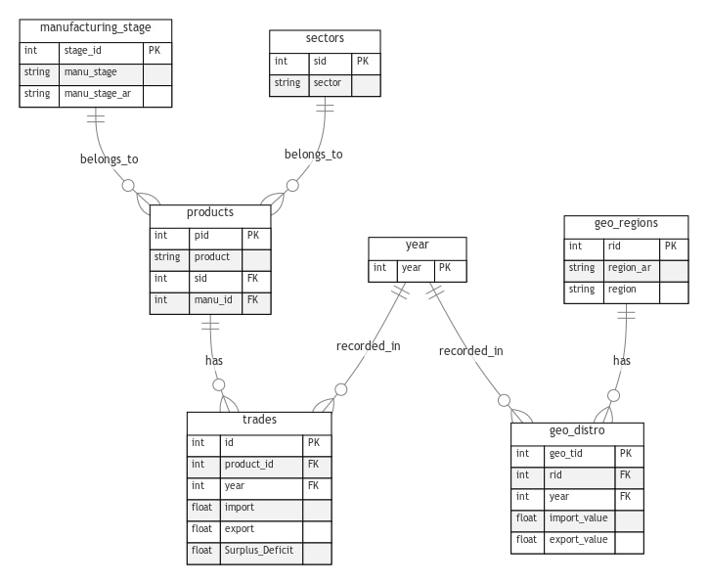
ER Diagram & Normalizing Data
1. Adding new 2 perceptive to the analysis )) Geographical Distribution – Manufacturing Stage ))
2. Plan for the ER Diagram and present planned schema using Mermaid.js
3. Normalizing the data tables into planned one
4. Export it into csv files to import it into sql server
Planned Schema

Slide 13
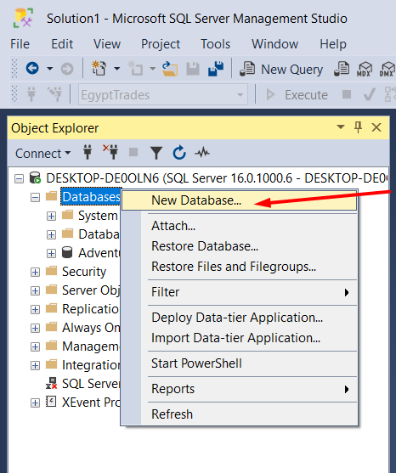
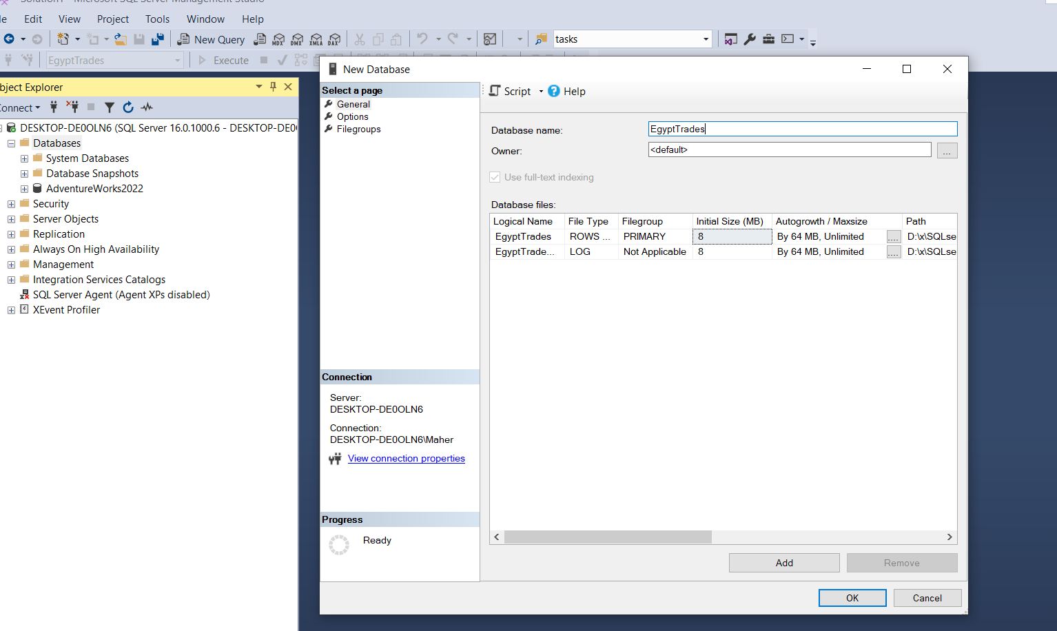
Creating physical Database

Slide 14
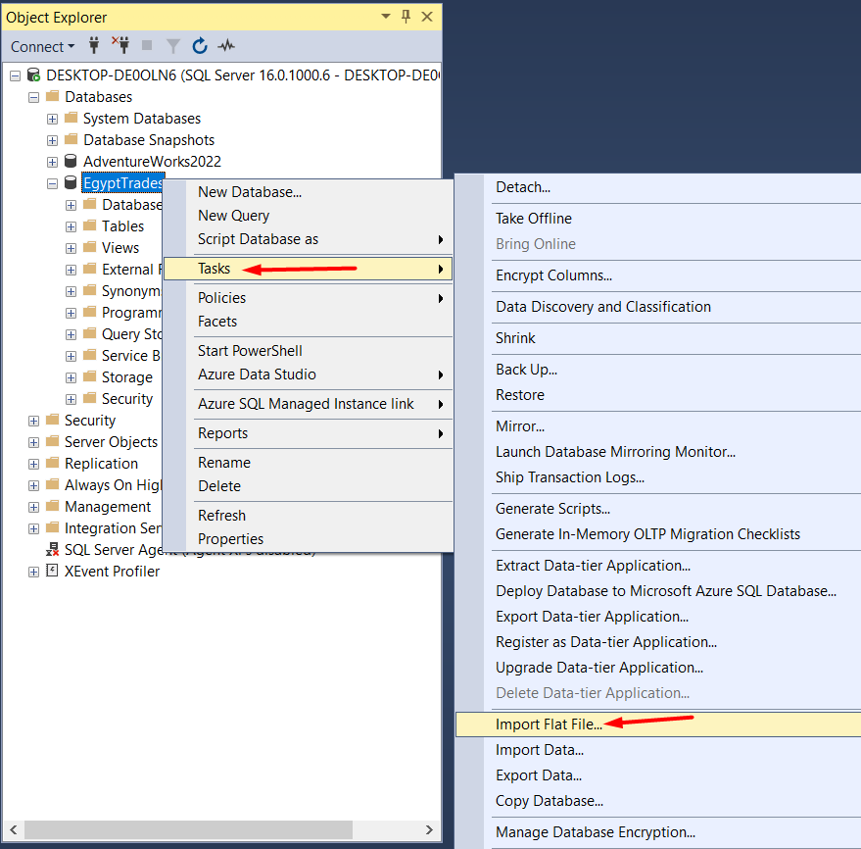
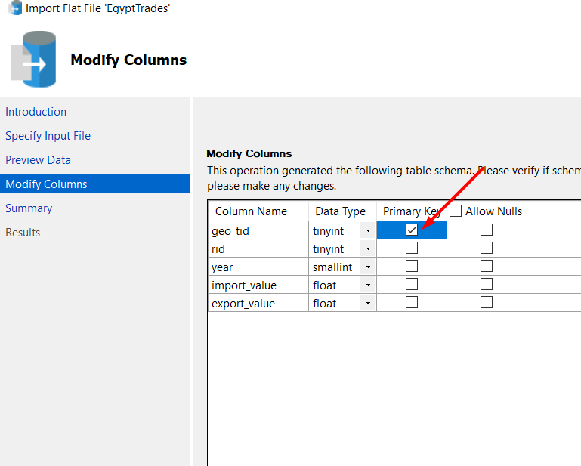
Importing the CSV files
Define Primary Keys

Slide 15
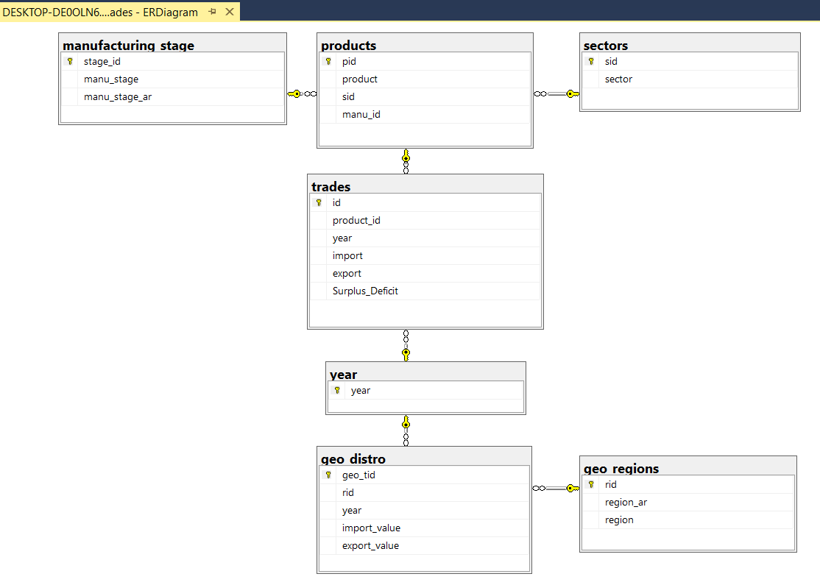
Creating Relations between tables and Final Logical Schema

Slide 16
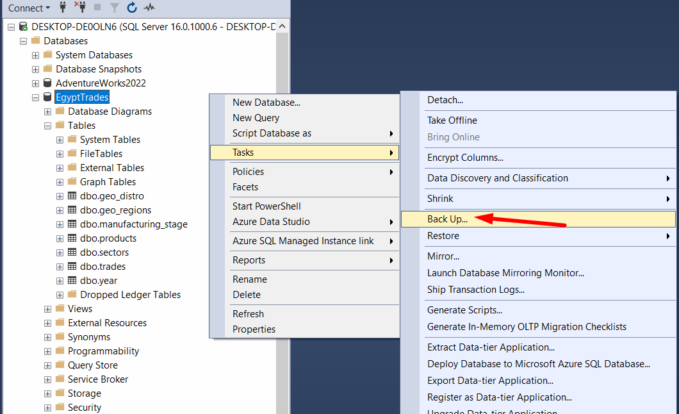
Export the Database into .bak file

Slide 17
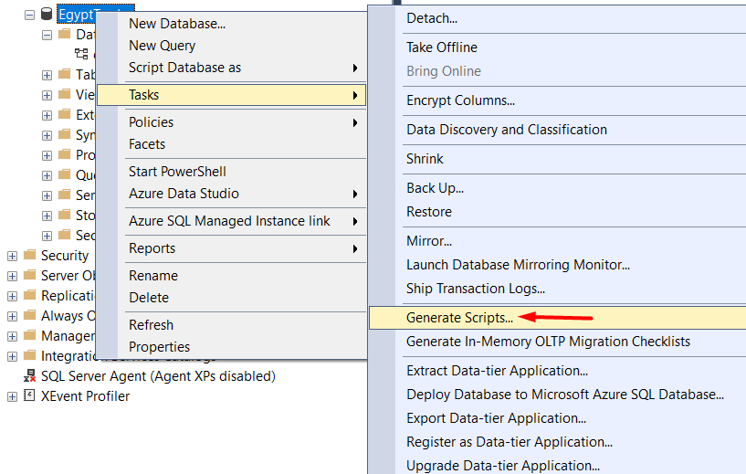
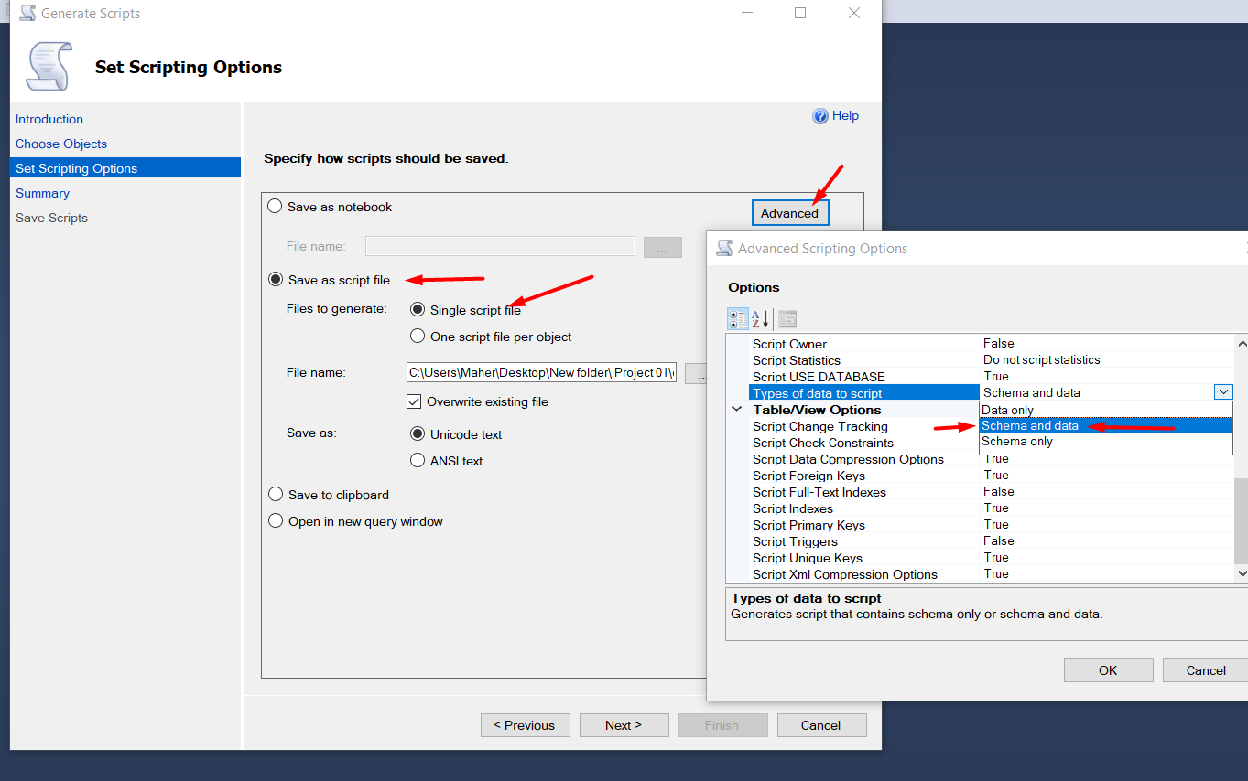
Export DB into SQL Script for Members with outdated ver.
Fully export of Database
(Schema and Data)

Slide 18
03
EDA Exploratory Data Analysis

Slide 19
EDA Key Metrics & Questions
KPIs
Questions
1- Total Annual Import Values
(product - economic sector - manufacturing stage – region)
2- Percentage Distributions
(total imports - Regional - Manufacturing stage – Sector)
3- Growth & Change Metrics
(Year-over-year change rates - Crisis period impact –
Sector growth rates)
1- Top Import Products (2005-2023) ?
2- Major Import Source Regions
3- Manufacturing Stage Distribution
4- Leading Import Sectors
5- Crisis Impact
6- Declining Import Sectors
7- Commodity Import Ratios
8- High-Growth Import Sectors

Slide 20
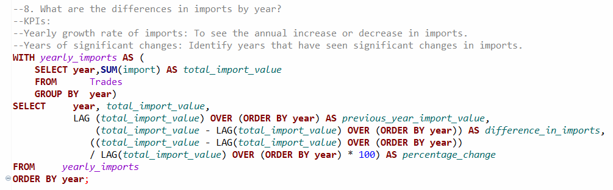
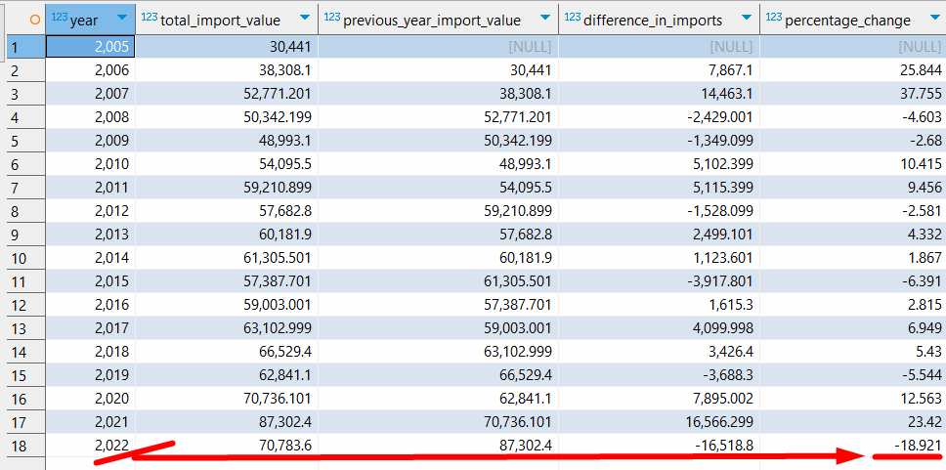
SQL queries
Applying multiple SQL queries to extract key findings

Slide 21
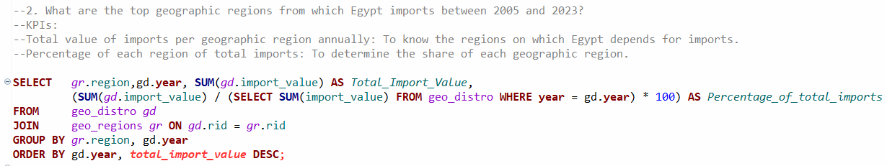
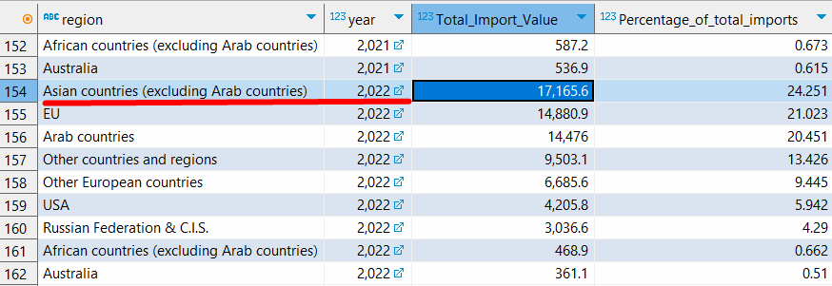
SQL queries
Applying multiple SQL queries to extract key findings

Slide 22
Key Findings
1. Overall Imports: Egypt's total imports rose from $28.66 billion in 2005 to $77.52 billion in 2023, indicating a substantial increase of 170%.
2. Top Trading Partners: The USA, China, and Germany were Egypt’s main suppliers in 2023, accounting for 42% of total imports.
3. Major Import Categories: Oil merchandise (17%), chemicals (8%), and base metals (7.5%).
4. Growth Trends: Significant growth in imports from China and the USA, with China’s share increasing from 6.8% in 2005 to 13.8% in 2023.
6. Raw Materials: Remained significant, peaking at $17.84 billion in 2017.
7. Intermediate Goods: Fluctuated, with a rise to $6.64 billion in 2021.Final Goods: Steady growth, especially in consumer non-durable goods, reaching $12.15 billion in 2021.

Slide 23
Key Findings
8. Raw materials averaged 20-24%, intermediate goods around 6-10%, and final goods grew over time.
9. Key Year: 2021 marked a peak in consumer non-durable goods due to changing demand.
10. Key Findings on Imports by Economic Sector (2005-2023)
Top Sector: Oil merchandise consistently had the highest import value, peaking at approximately $12.49 billion in 2017.
Other Significant Sectors: Base metals & products and chemicals merchandise were major contributors. Vehicles, cars, and transportation also recorded substantial imports.
11. Impact of Global Economic Crises on Egypt's Imports
2008 Financial Crisis: Total Imports (2008): $50.34 billion. Decline in 2009: Imports fell to $48.99 billion, a decrease of 2.68%.
COVID-19 Pandemic: Total Imports (2020): $70.74 billion. Significant Growth in 2021: Imports surged to $87.30 billion, reflecting a 23.42% increase from 2020.

Slide 24
Key Findings
12. Total imports Yearly Growth Rates:
2021: Peak increase of 23.42%.
2022: Notable decline of 18.92% after a peak in 2021.
13. Most Significant Declines in Imports (2022):
Vehicles & Transportation: Decline: $2.68 billion
Base Metals & Products: Decline: $1.89 billion
Chemicals Merchandise: Decline: $1.81 billion
14. Least Significant Declines in Imports (2022):
Oil Merchandise: Decline: $138.10 million
Machinery & Equipment: Decline: $1.27 billion
Cotton & Textiles: Decline: $1.29 billion

Slide 25
04
Predictive Analysis

Slide 26
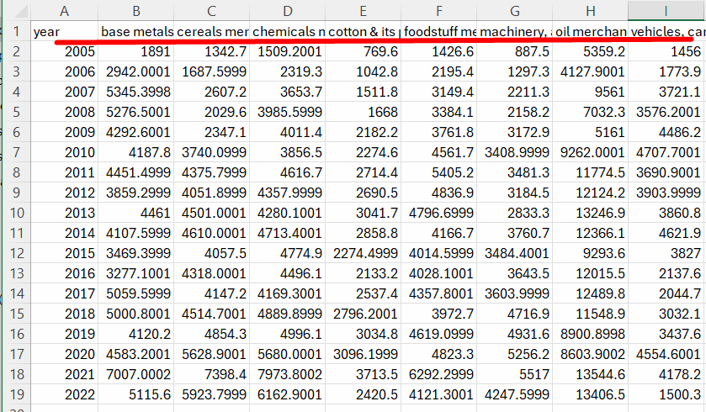
Data preprocessing
1- Targeting Sectors Imports only for analysis
2. Remove unwanted columns using power query
3- Transform the data to have a chronological time order by pivoting.

Slide 27
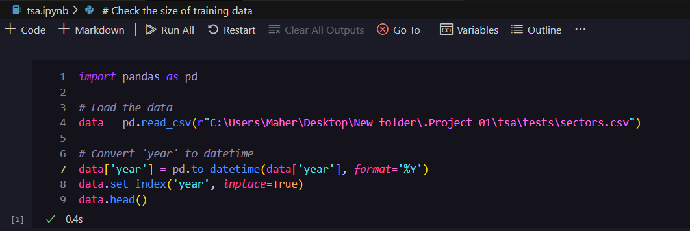
Data preprocessing using Python
1- Import the csv with Pandas Library
2- Change year column datatype to Datetime
3- Indexing the Dataframe with year column

Slide 28
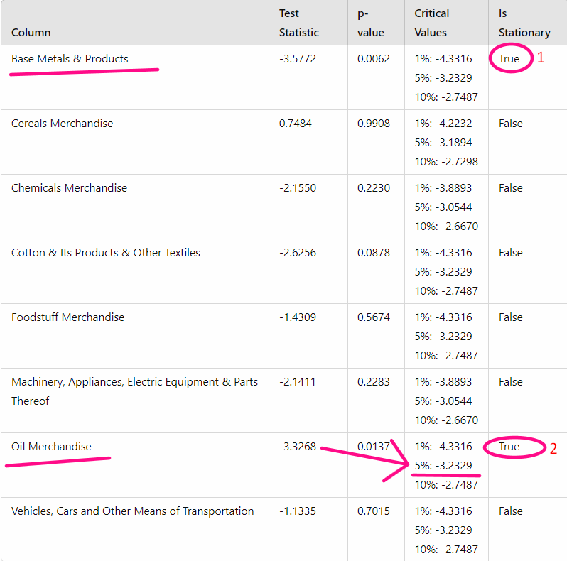
Checking for stationary
1- Appling the ADfuller Test on columns to check for stationary
2- Target: Predicting the values of imports for oil sector for next 3 years
2- Indexing the Dataframe with year column
• P-Value < 0.05
• T-stat < 5% crit value
Which indicate that
Oil sector is stationary
*Picking a TSA model
• non-integrated models
Used for stationary data
• integrated models
Used for Non-stationary

Slide 29
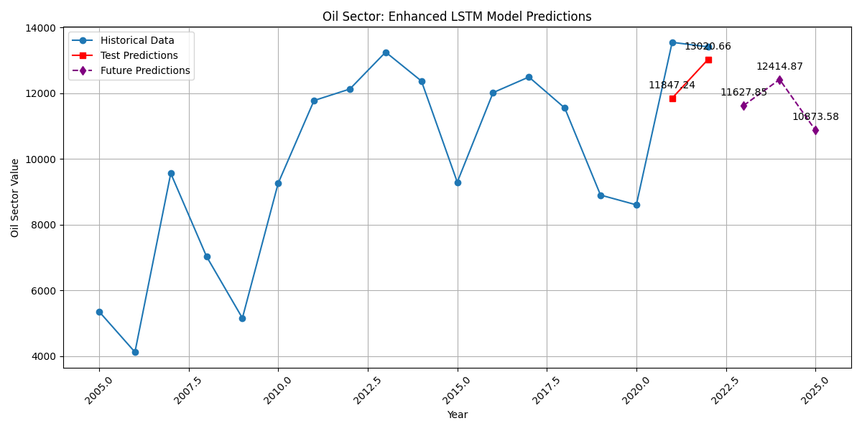
Predictions
1- Due to the short length of the provided data there was no Accurate TSA model
could reliably predict the testing set
2- We ended Using Keras library specifically LSTM model
* Predicted Values For Oil Imports next 3y
• 2023 : $11.62 billion
will decrease ▼
• 2024 : $12.41 bn
slightly increase ▲
• 2025 : $10.87 bn
further decrease ▼▼

Slide 30
05
Data Visualization

Slide 31
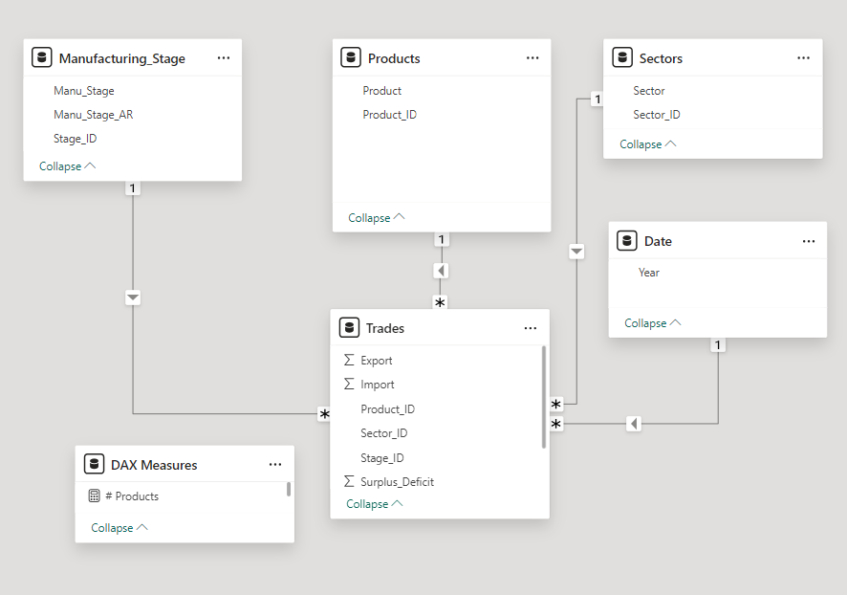
Star Schema Using PowerBI
Trades as
Fact Table

Slide 32
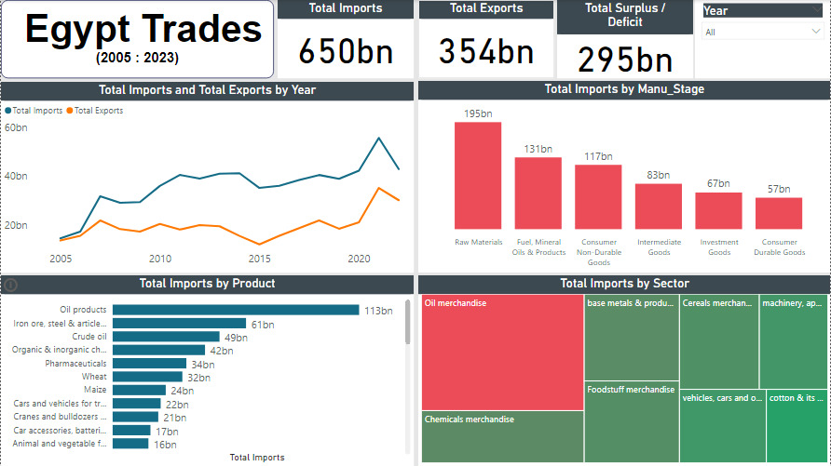

Slide 33
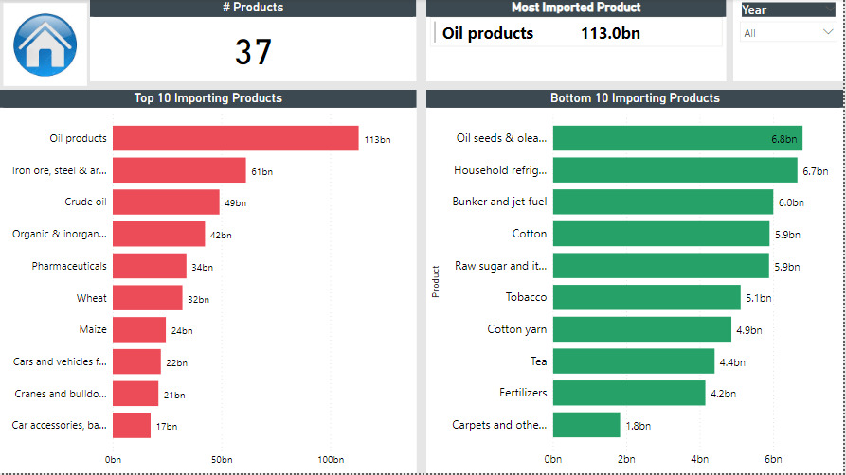

Slide 34
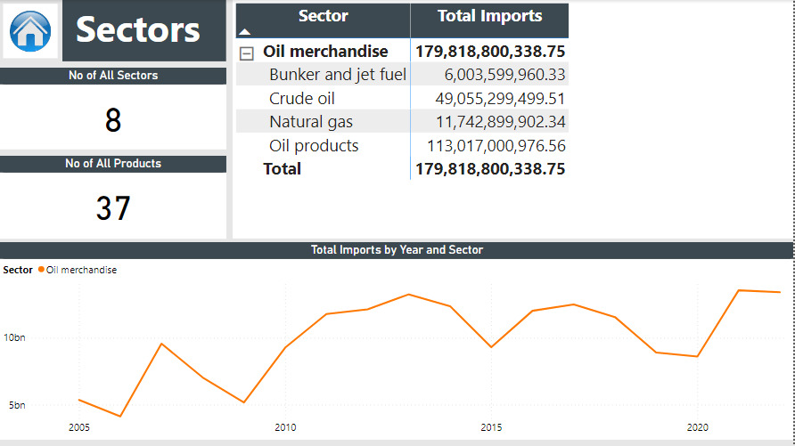

Slide 35
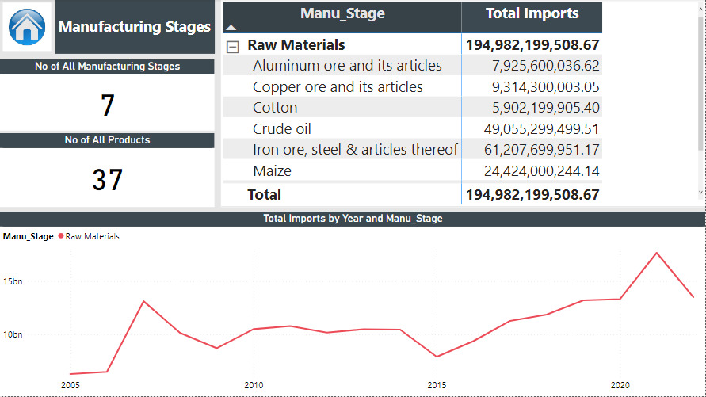

Slide 36
06
Recommendations and solutions study

Slide 37
Recommendations for Policymakers
• Promoting Domestic Production:
1- Provide Targeted Incentives: Offer tax breaks, subsidies, and other incentives to encourage domestic production of key imported goods, such as food, pharmaceuticals, and manufacturing inputs.
2- Improve Business Environment: Simplify regulatory procedures, reduce bureaucratic hurdles, and provide access to affordable financing to facilitate domestic investment and entrepreneurship.
3- Invest in Research and Development: Support research and development activities to enhance domestic innovation and competitiveness, enabling local industries to produce high-quality products that can compete with imports.

Slide 38
Recommendations for Policymakers
• Power Sector Development:
4- Diversify Energy Sources: Invest in renewable energy projects such as solar and wind to reduce dependency on oil.
5- Expand Natural Gas Utilization: Increase the use of domestic natural gas in power generation as a cleaner alternative to oil.
6- Promote Electric Mobility: Encourage the adoption of electric vehicles (EVs) by building charging infrastructure and transitioning public transport to electric power, reducing oil consumption in transportation.

Slide 39
Recommendations for Policymakers
• Agricultural Development:
7- Modernize Farming Practices: Promote the adoption of modern farming techniques, such as precision agriculture and sustainable farming methods, to increase yields and reduce reliance on imported inputs.
8- Invest in Irrigation Systems: Improve irrigation infrastructure to ensure adequate water supply for agriculture, especially in arid regions.
9- Support Value-Added Agriculture: Encourage the development of value-added agricultural industries, such as food processing and packaging, to increase domestic value-capture and reduce reliance on raw material exports.

Slide 40
Recommendations for Policymakers
• Industrial Development:
10- Attract Foreign Investment: Create a favorable investment climate to attract foreign direct investment (FDI) in manufacturing and other sectors. This can involve providing tax incentives, infrastructure support, and a skilled workforce.
11- Promote Industrial Clusters: Develop industrial clusters to foster collaboration, knowledge sharing, and economies of scale among domestic firms.
12- Enhance Technical Skills: Invest in vocational training and education to equip the workforce with the skills needed to meet the demands of modern industries.

Slide 41


Thanks!
Do you have any questions?
Feel free to ask!
Google Drive Link for the project
GitHub repo link for the project

